Slide 1






Slide 2

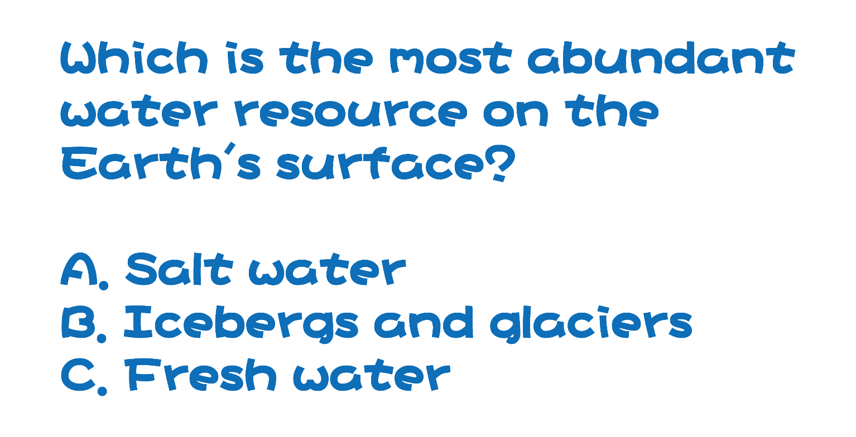

Slide 3

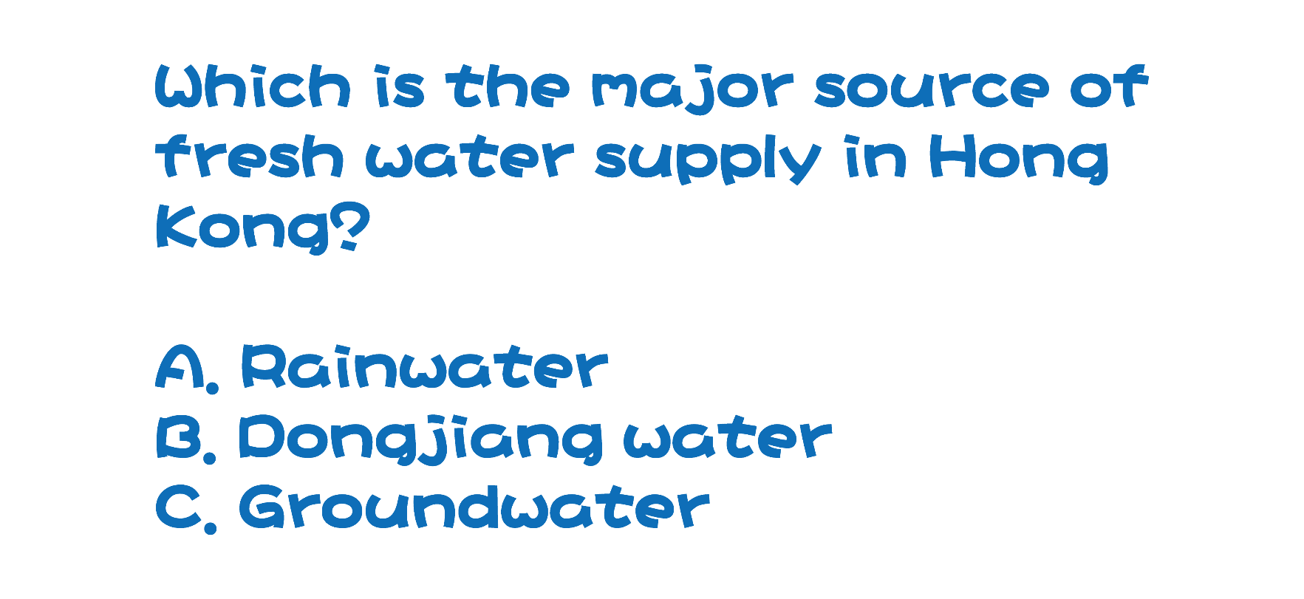

Slide 4

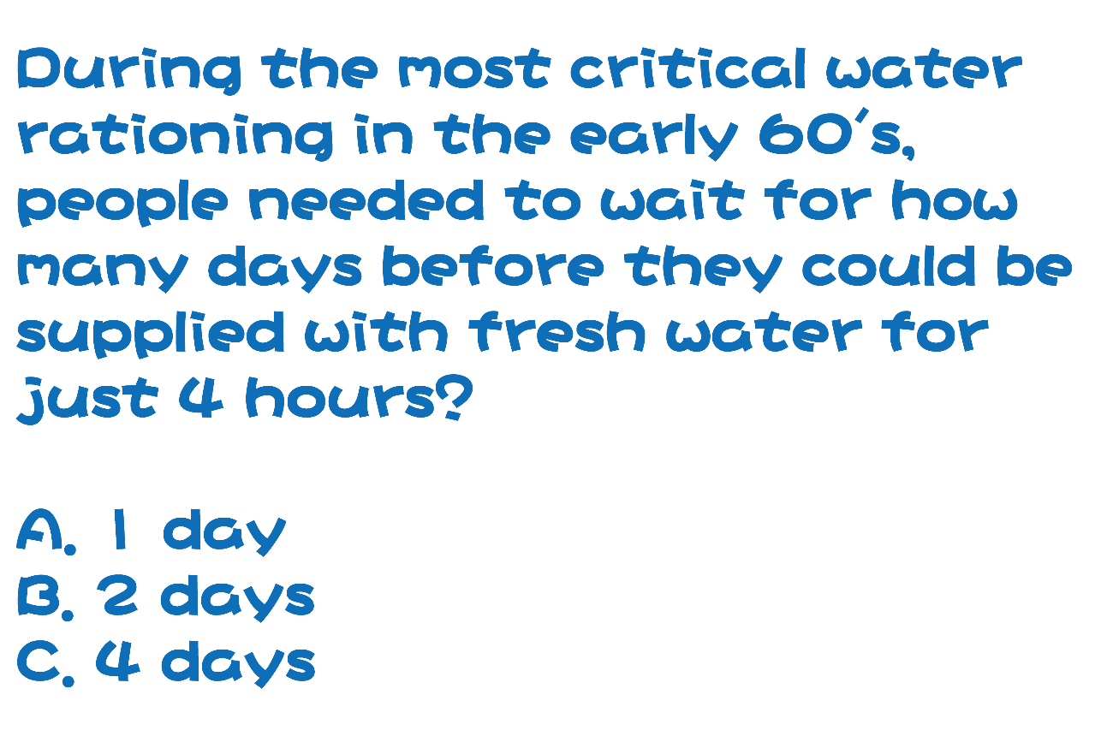

Slide 5



Slide 6

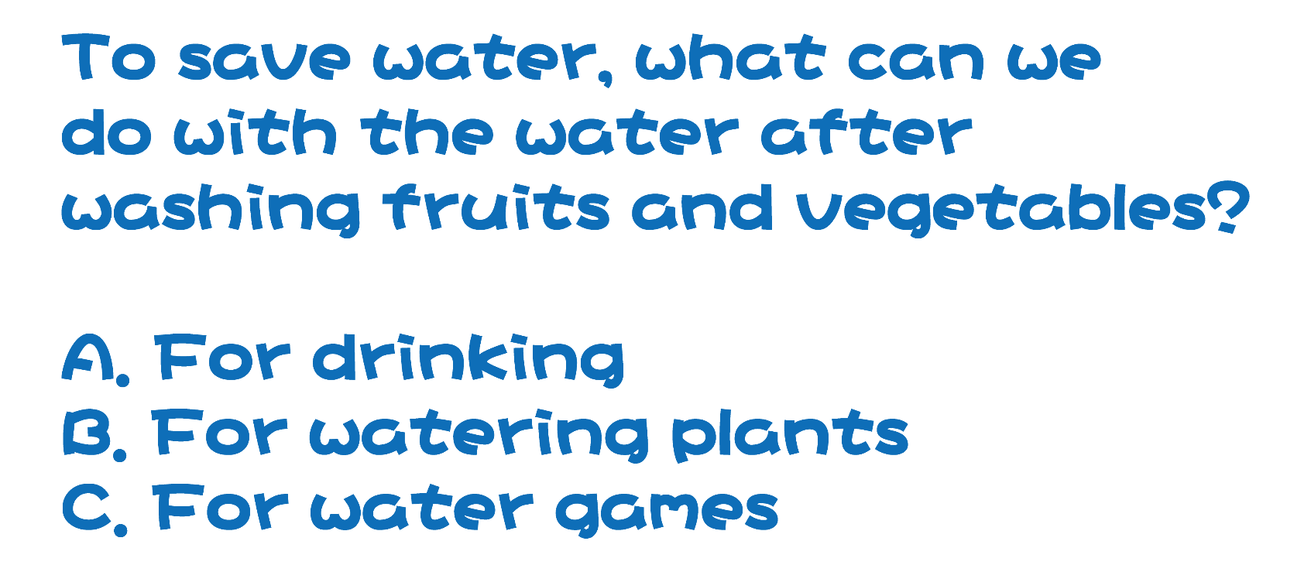

Slide 7

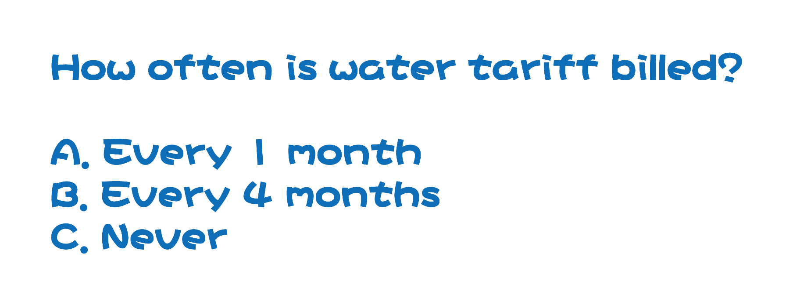

Slide 8

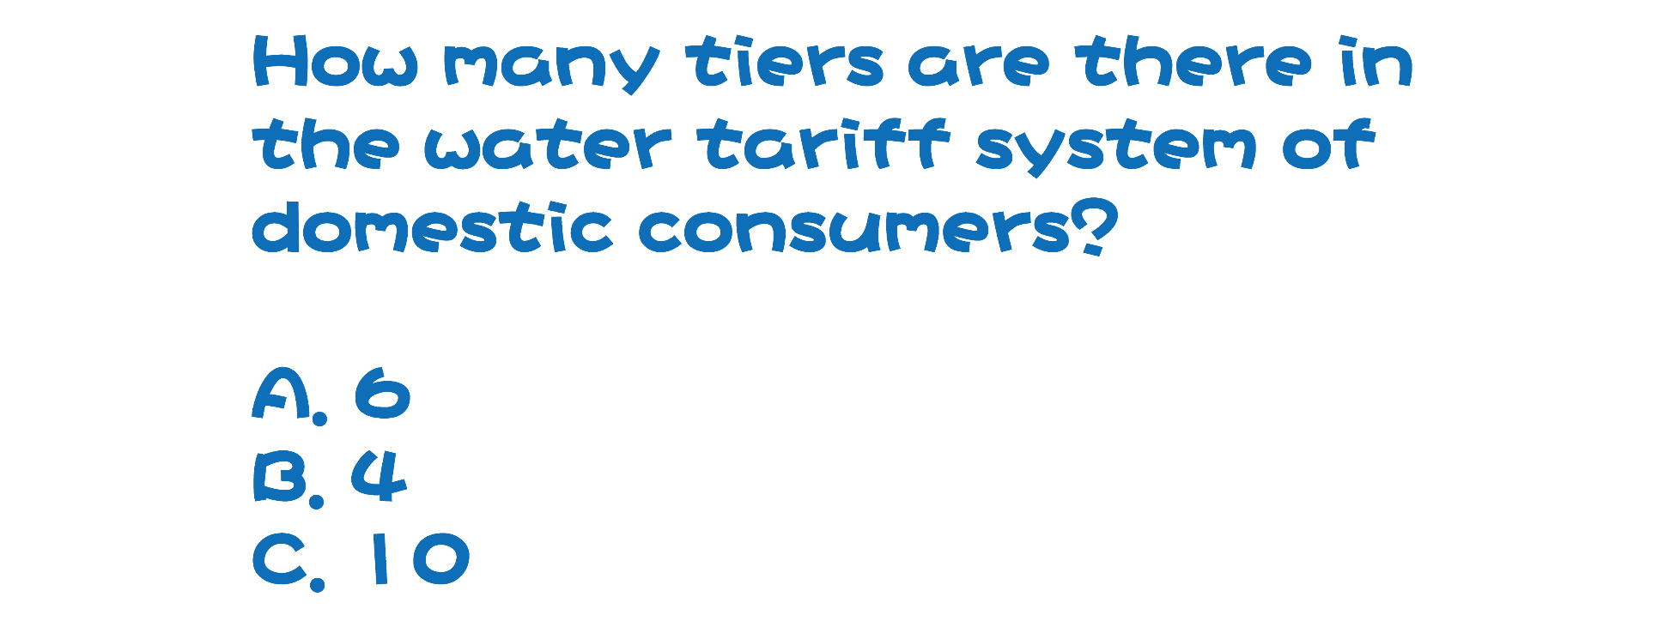

Slide 9



Slide 10

TV Announcement:
“Save Water for the Future
Every Drop Counts”
Please click here to watch the video

Slide 11

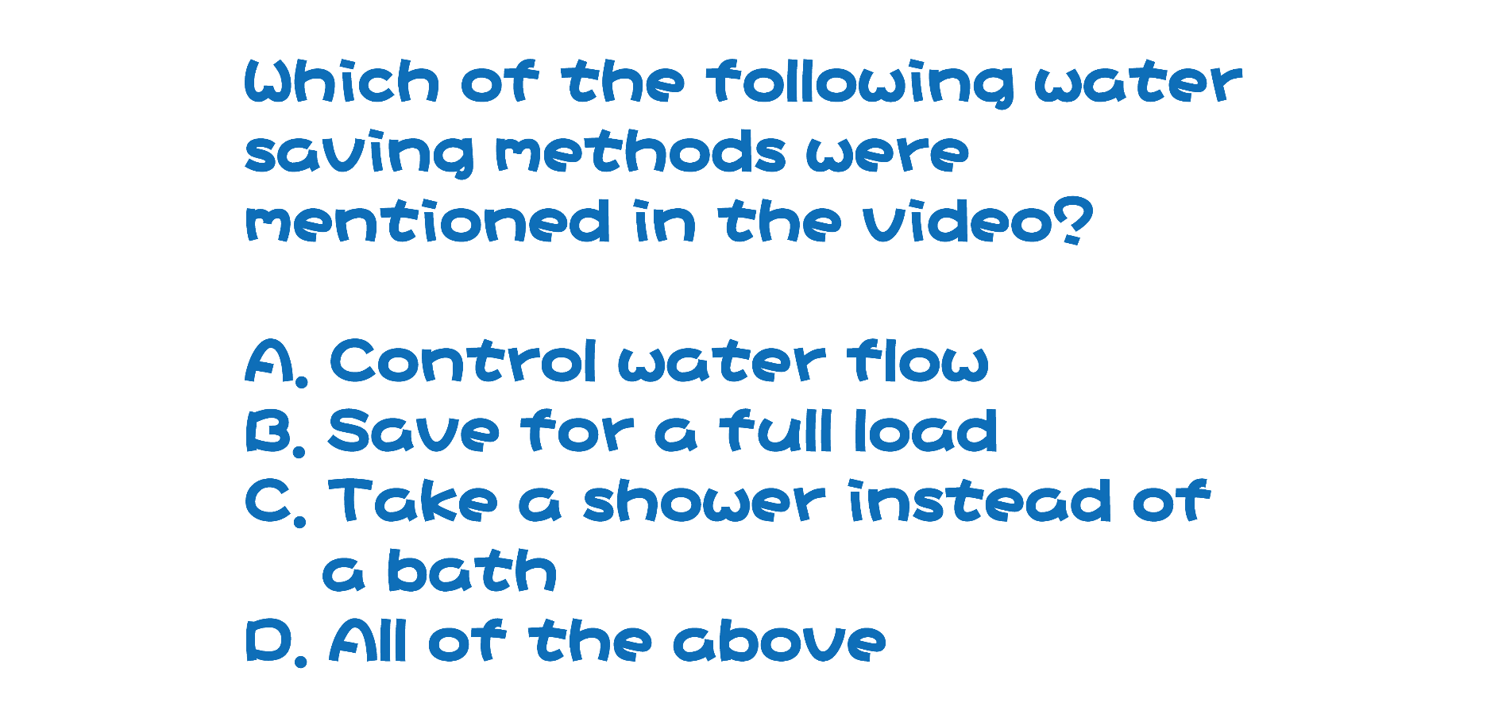

Slide 12

TV Announcement:
“Save Water,
Take Shorter Showers”
Please click here to watch the video

Slide 13

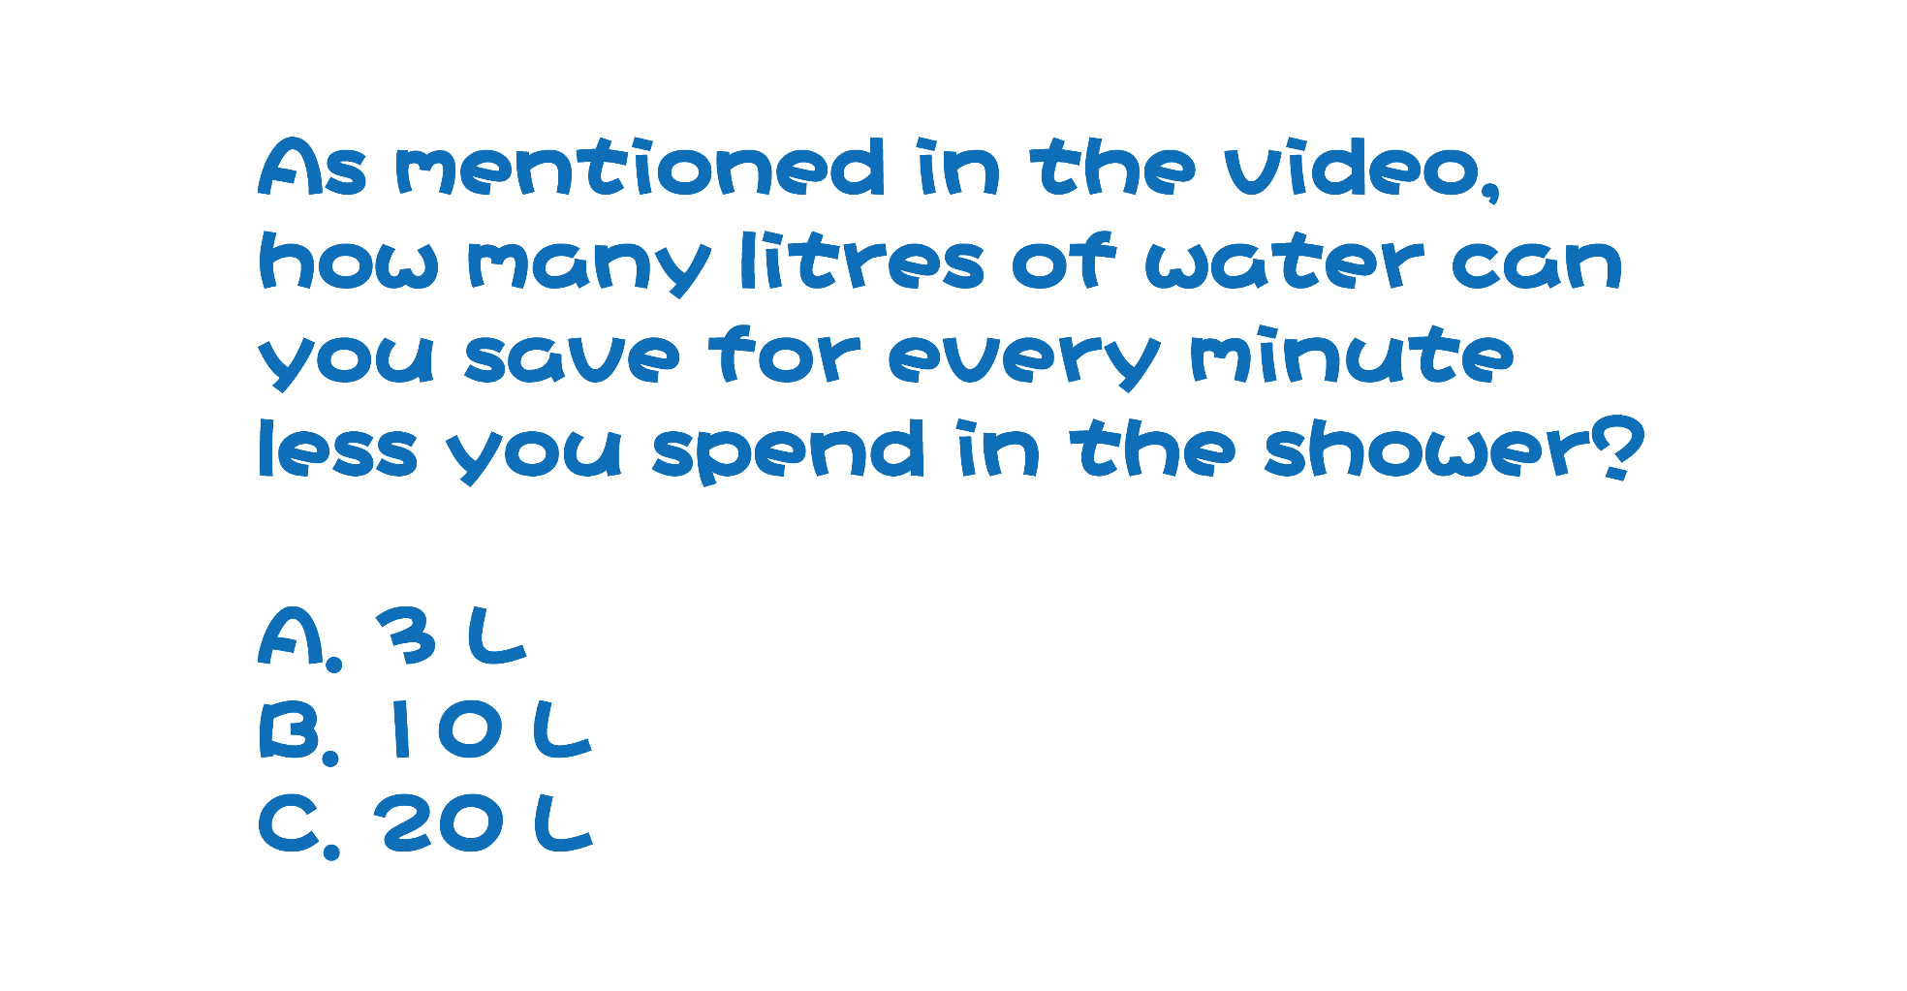

Slide 14



